Slide 1
Mitosis and Meiosis

Slide 2
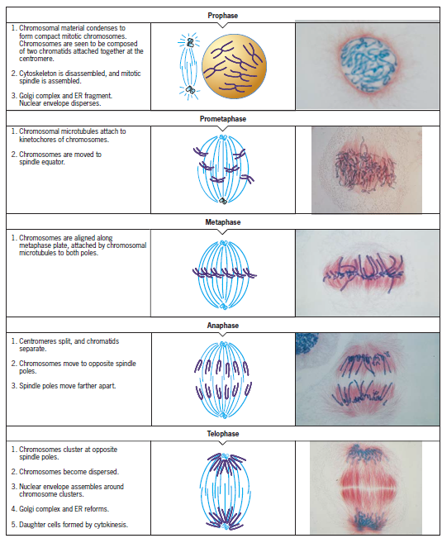
Mitosis

Slide 3
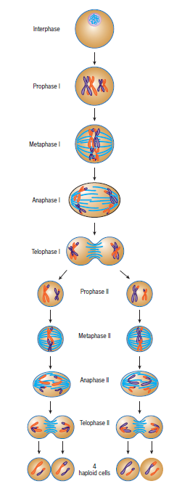
Meiosis

Slide 4
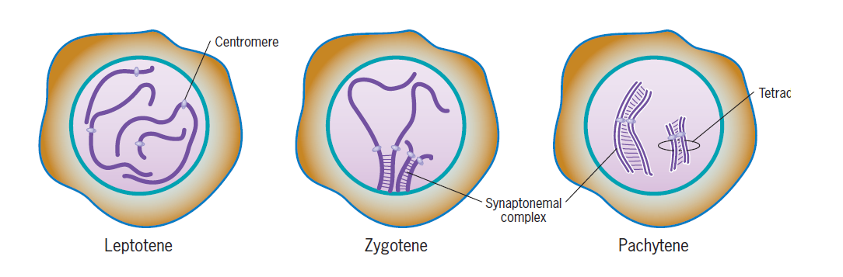
Meiosis
The first stage of prophase I is leptotene , during which the chromosomes become compacted and visible.
The second stage of prophase I, which is called zygotene , is marked by the visible association of homologues with one another. This process of chromosome pairing is called synapsis and is an intriguing event.
The complex formed by a pair of synapsed homologous chromosomes is called a bivalent or a tetrad . The former term reflects the fact that the complex contains two homologues, whereas the latter term calls attention to the presence of four chromatids. The end of synapsis marks the end of zygotene and the beginning of the next stage of prophase I, called pachytene (Figure), which is characterized by a fully formed synaptonemal complex. During pachytene, the homologues are held closely together along their length by the SC. The DNA of sister chromatids is extended into parallel loops.

Slide 5
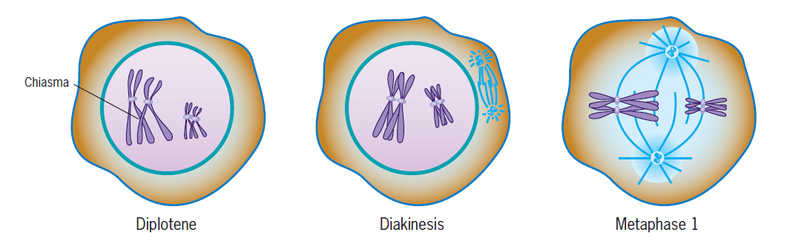
Meiosis
Diplotene is recognized by the dissolution of the SC, which leaves the chromosomes attached to one another at specific points by X‐shaped structures, termed chiasmata (singular chiasma )
Chiasmata are located at sites on the chromosomes where crossing‐over between DNA molecules from the two chromosomes had previously occurred. Chiasmata are formed by covalent junctions between a chromatid from one homologue and a nonsister chromatid from the other homologue. These points of attachment provide a striking visual portrayal of the extent of genetic recombination.
In diakinesis ,the meiotic spindle is assembled and the chromosomes are prepared for separation Diakinesis ends with the disappearance of the nucleolus, the breakdown of the nuclear envelope, and the movement of the tetrads to the metaphase plate

Slide 6
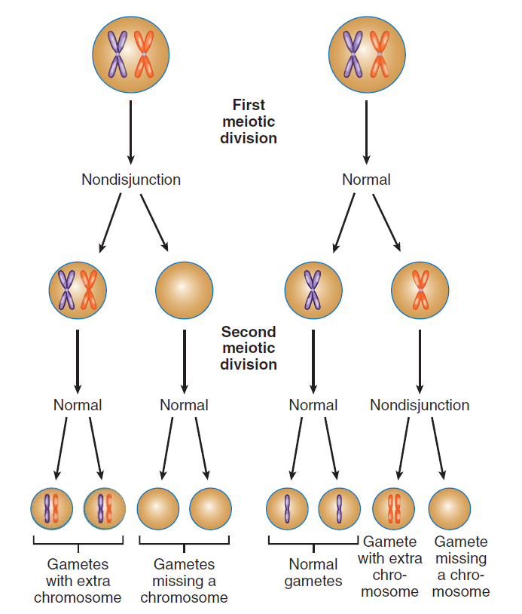
Meiotic Nondisjunction and Its Consequences
Meiotic nondisjunction occurs when chromosomes fail to separate from each other during meiosis. If the failure to separate occurs during the first meiotic division, which is called primary nondisjunction , all of the haploid cells have an abnormal number of chromosomes. If nondisjunction occurs during the second meiotic division, which is called secondary nondisjunction , only two of the four haploid cells are affected. (More complex types of nondisjunction than shown here can also occur.

Slide 7
Down syndrome
The karyotype of a person with Down syndrome. The
karyotype shows an extra chromosome 21 (trisomy 21).

Slide 8
Turner syndrome and Klinefelter syndrome
A zygote with only one X chromosome and no second sex chromosome (denoted as XO) develops into a female with Turner syndrome , in which genital development is arrested in the juvenile state, the ovaries fail to develop, and body structure is slightly abnormal. Because a Y chromosome is male determining, persons with at least one Y chromosome develop as males.
A male with an extra X chromosome (XXY) develops Klinefelter syndrome , which is characterized by mental retardation, underdevelopment of genitalia, and the presence of feminine physical characteristics (such as breast enlargement).
A zygote with an extra Y (XYY) develops into a physically normal male who is likely to be taller than average. Considerable controversy developed surrounding claims that XYY males tend to exhibit more aggressive, antisocial, and criminal behavior than do XY males

Slide 9
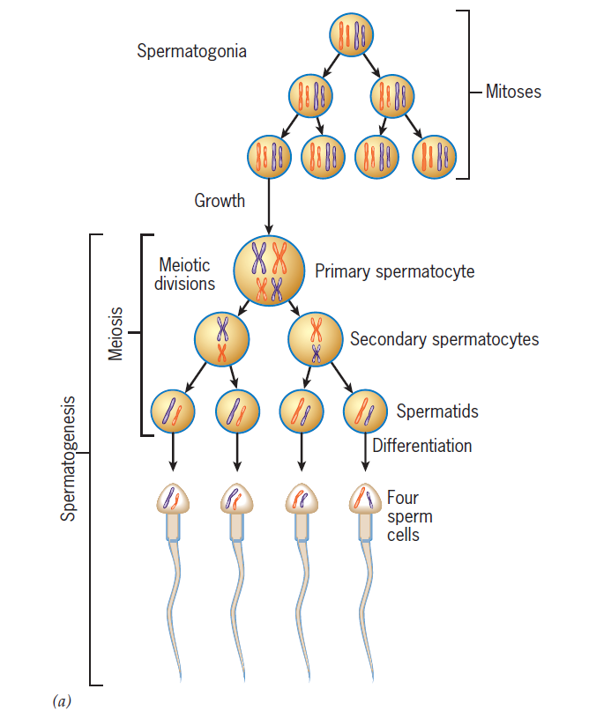
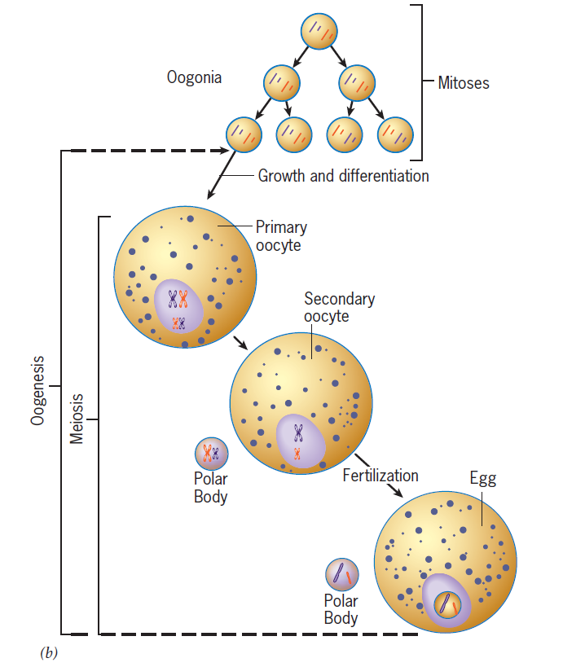
Spermatogenesis and Oogenesis

Slide 10

References

